Slide 1

Quantum Enhanced Machine Learning:
Algorithmic Approach and Implementation
Project Guide: Prof. K Vedavathi, HoD,
Dept. of Computer Science
V BENHUR PRADEEP
MSc DS 2019-21
Reg. No. 121922502037
Date: 16-03-2021
Project review II
Dept. of Computer Science
GITAM Deemed to be University

Slide 2
TensorFlow Quantum library
TensorFlow Quantum (TFQ) is a quantum machine learning library for rapid prototyping of hybrid quantum-classical ML models.
Research in quantum algorithms and applications can leverage Google’s quantum computing frameworks, all from within TensorFlow.

Slide 3
Cirq:
Cirq is a software library for writing, manipulating, and optimizing quantum circuits and then running them against quantum computers and simulators.
Cirq attempts to expose the details of hardware, instead of abstracting them away, because, in the Noisy Intermediate-Scale Quantum (NISQ) regime, these details determine whether or not it is possible to execute a circuit at all.

Slide 4
Quantum Circuits:
We define a Quantum Circuit using Cirq

Slide 5
https://github.com/benhurpradeep1/QML-PROJECT-MS-DS/blob/main/Quantum_model_(1).ipynb

Slide 6
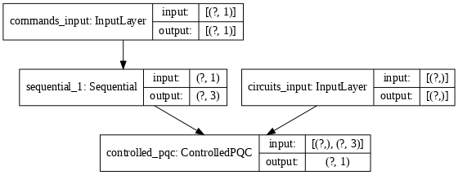
The full Keras model is built from the Dense layer and TFQ layer

Slide 7
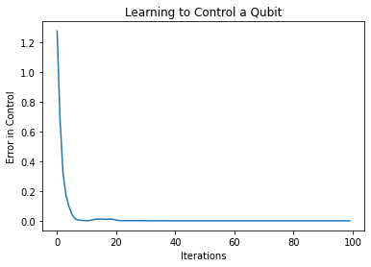
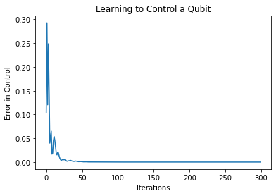

Slide 8
Steps involved:
Import code libraries
Define quantum circuits
Develop a neural network to control it
Connect the controller and quantum circuit
Create inputs for both controller and quantum circuit
Combine them by creating layers
Mis calibrate our circuit input
Check whether our qubit produce the correct output for our input data
Train the qubit to learn more than 2 data points

Slide 9
Build a Quantum CNN

Slide 10
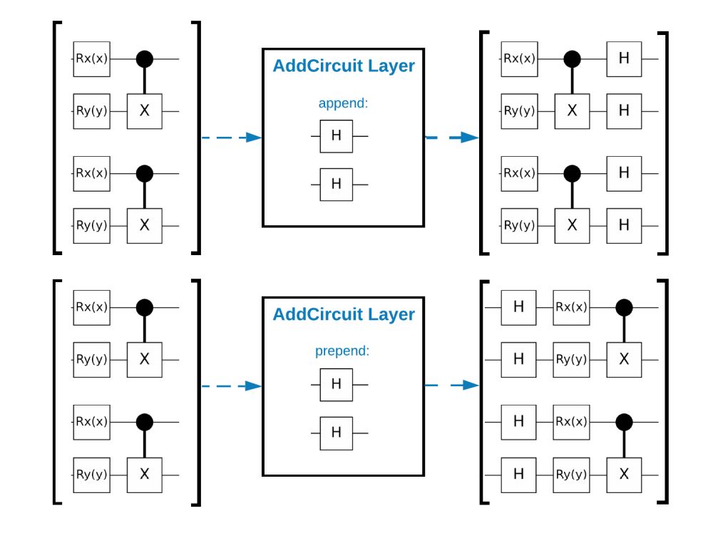
Quantum Convolutional Neural Network

Slide 11
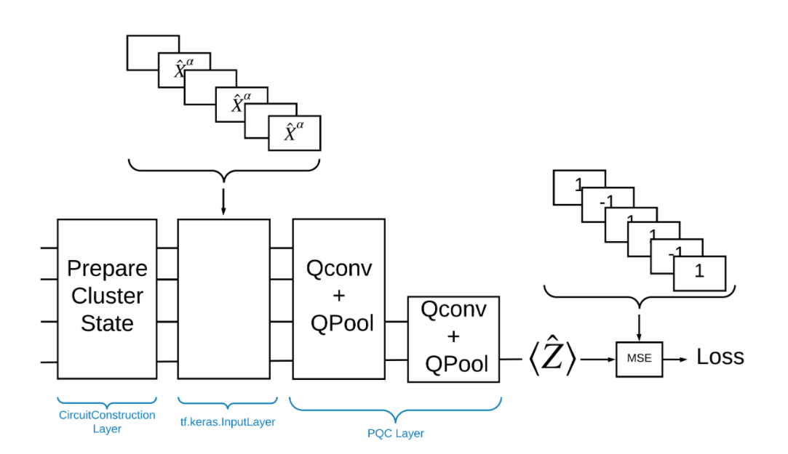
Building blocks for TensorFlow

Slide 12
To Solve the problem with TensorFlow Quantum implement the following:
The input to the model is a circuit tensor-either an empty circuit or an X gate on a particular qubit indicating an excitation.
The rest of the model's quantum components are constructed with tfq.layers.AddCircuit layers.
For inference a tfq.layers.PQC layer is used. This reads ⟨Z^⟩ and compares it to a label of 1 for an excited state, or -1 for a non-excited state.

Slide 13
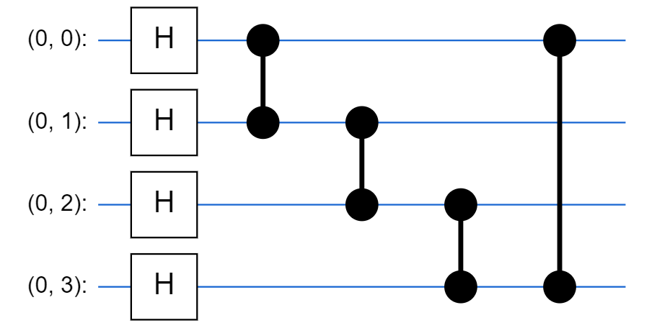
Cluster state circuit

Slide 14
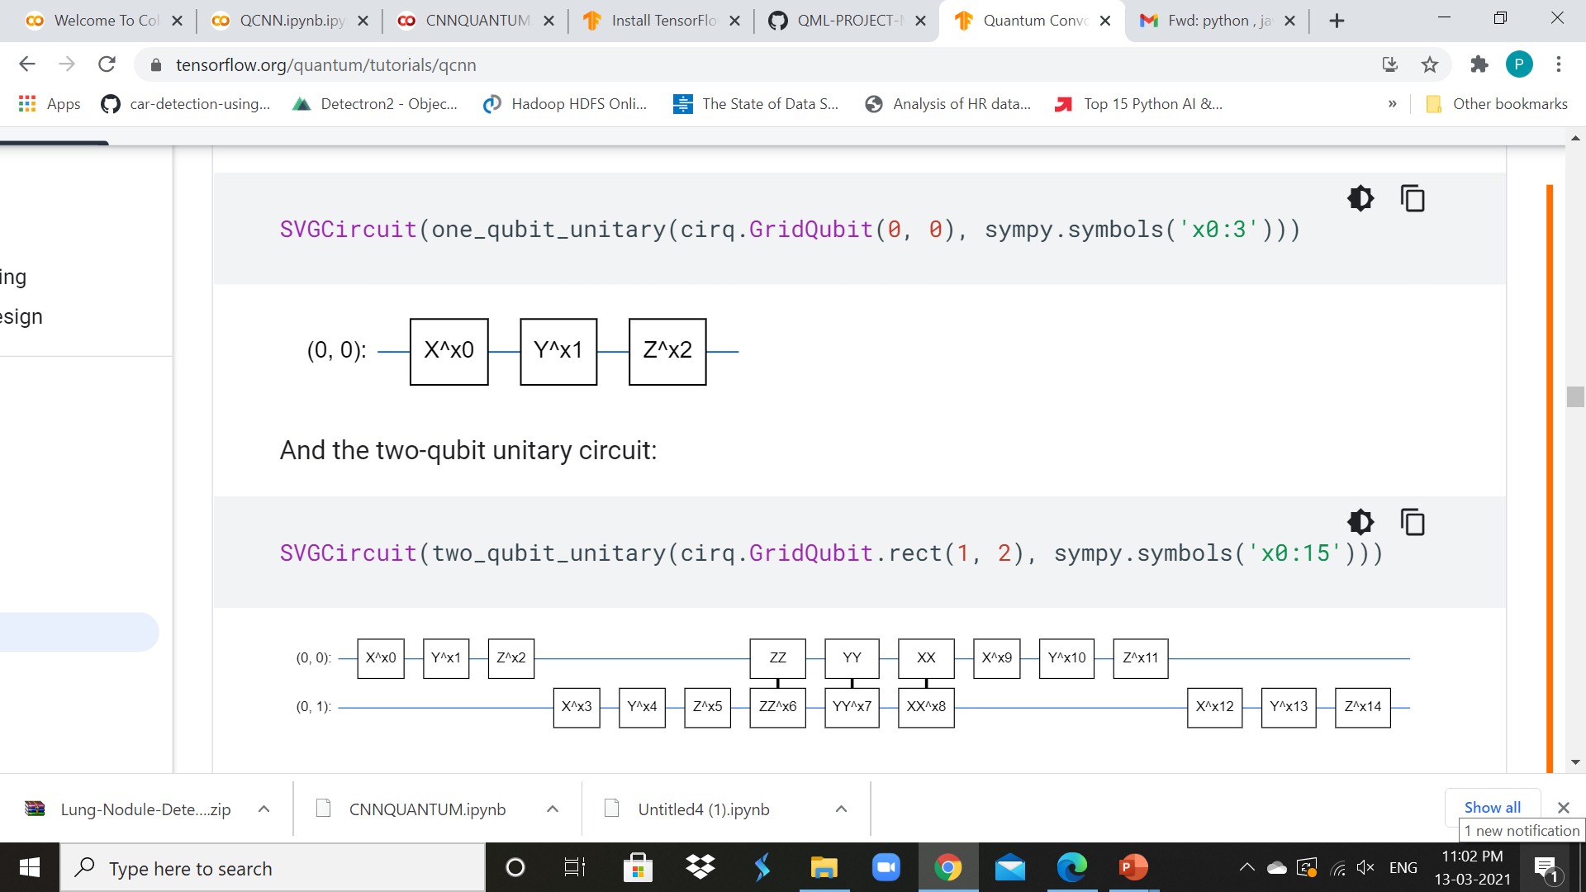
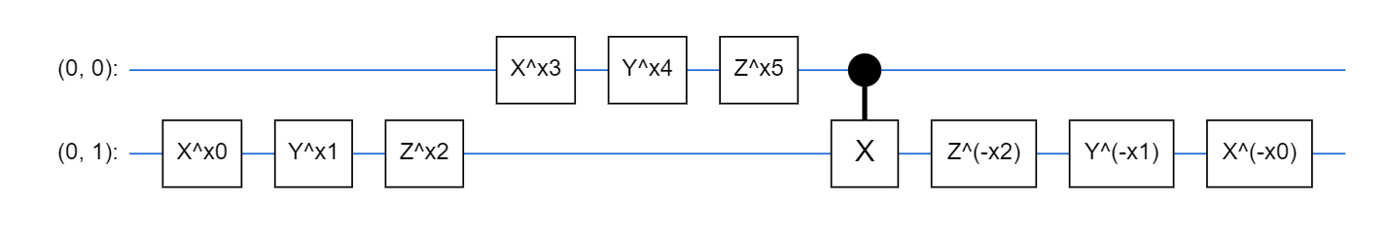
One-qubit unitary circuit
Two-qubit unitary circuit
Two-qubit pooling circuit

Slide 15
Quantum convolutional and Pool Circuit
https://github.com/benhurpradeep1/QML-PROJECT-MS-DS/blob/main/CNNQUANTUM.ipynb

Slide 16
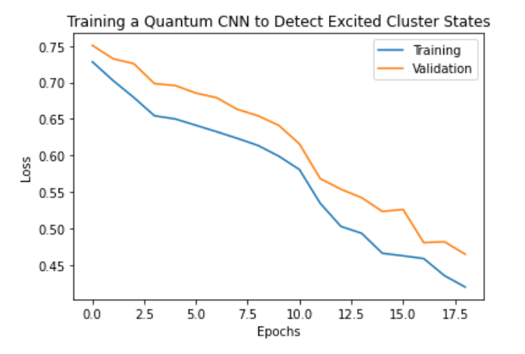
Training a Quantum CNN

Slide 17
Proposed Algorithm For Q KNN
To develop a quantum analogue of the k-means algorithm, called q-means. The steps are done in quantum superposition
This is purely a theoretical algorithm that has not yet been tested on an actual quantum computer nor a classical simulator

Slide 18
Alg. Steps
1 - We start in a quantum superposition of all vectors in the dataset, and we compute simultaneously all distances to each one of the k centroids.
2 - We can then label all vectors simultaneously by choosing their closest centroid. All labels are written in a quantum state, in superposition too.
3 - We then measure and label qubits. Quantum physics tells us that we will randomly see only one label : it means that the remaining quantum state is a superposition of all vectors with that label .

Slide 19
Cont.
4 - Using quantum matrix multiplication, we can obtain a quantum state describing the new centroid.
5 - We perform tomography to retrieve the classical version of the new centroid
6 - We redo the last steps until we have the k new centroids.

Slide 20
Regarding Research Publication
Will publish in either Scopus indexed or UGC approved journal according to their constraints.
(Madam has guided me how to start with the work, will ensure to accomplish the work)

Slide 21
THANK YOU

